Slide 1
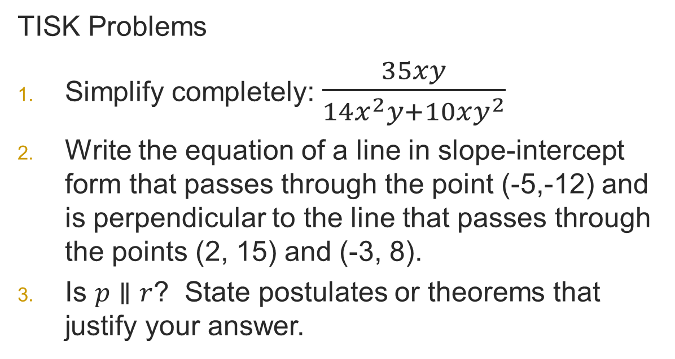
Tuesday, February 12, 2013
Agenda
TISK / No MM
Lesson 9-6 Secants, Tangents, & Angle Measures
Homework: 9-6 problems in packet 2
TISK Problems
Simplify completely: $\frac{35xy}{14x^{2}y+10xy^{2}}$
Write the equation of a line in slope-intercept form that passes through the point (-5,-12) and is perpendicular to the line that passes through the points (2, 15) and (-3, 8).
Is $p∥r$? State postulates or theorems that
justify your answer.
p
r
8
5
7
6
n
2
1
10
3
4
9
11
12
m

Slide 2
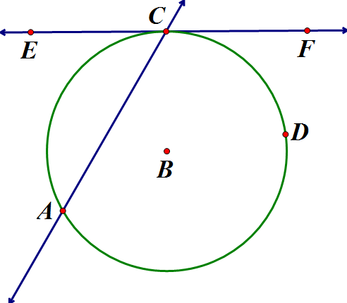
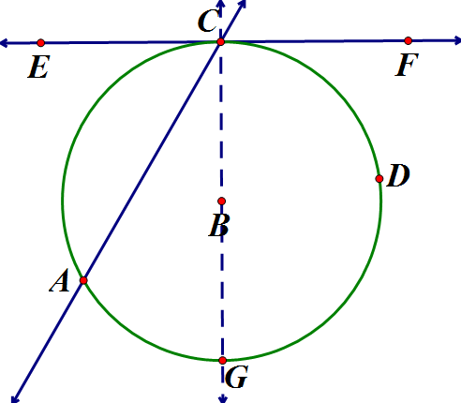
Look at the following tangent and secant in B:
What do you suppose the measure of is? How could we prove it?

Slide 3


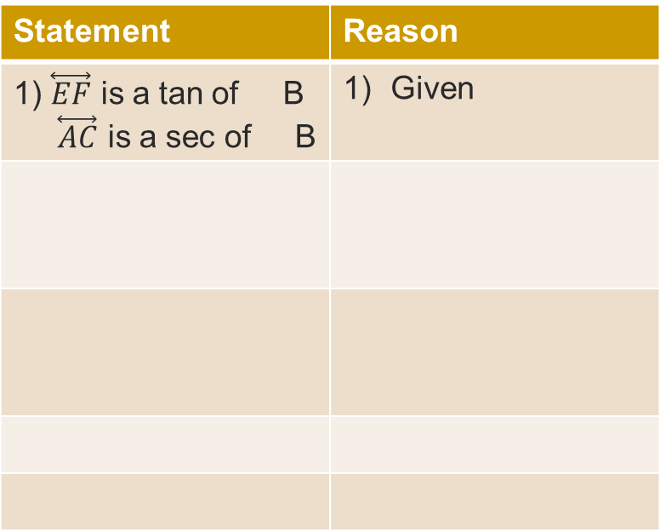

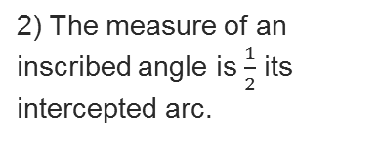


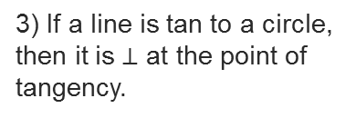

Look at the following tangent and secant in B:
Statement | Reason
1) $\overset{⃡}{EF}$ is a tan of B $\overset{⃡}{AC}$ is a sec of B | Given
2) $m∠ACG=\frac{1}{2}m$
2) The measure of an inscribed angle is $\frac{1}{2}$ its intercepted arc.
3) $\overline{BC}⊥\overline{EF}$
3) If a line is tan to a circle, then it is $⊥$ at the point of tangency.
4) $∠ECG is a rt ∠$
4) Def $⊥$
5) $m∠ECG=m∠ECA+m∠ACG$
5) $∠+$ Post.

Slide 4







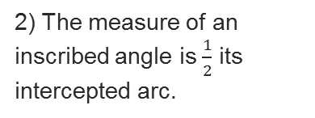











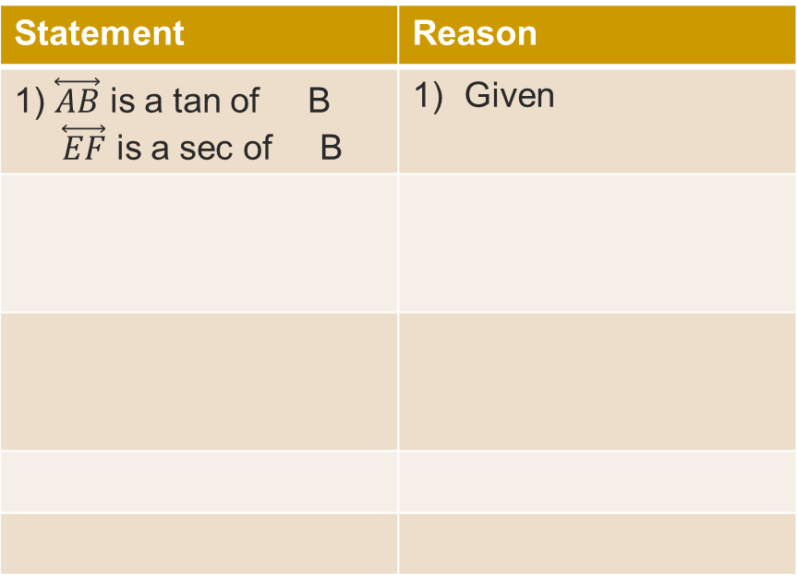
§9-6 Secants, Tangents, & Angle Measures
Statement | Reason
1) $\overset{⃡}{AB}$ is a tan of B $\overset{⃡}{EF}$ is a sec of B | Given
Statement | Reason
13) $0=m∠ECA−\frac{1}{2}m$
13) - prop.
of =
2) $m∠ACG=\frac{1}{2}m$
2) The measure of an inscribed angle is $\frac{1}{2}$ its intercepted arc.
14) $\frac{1}{2}m =m∠ECA$
14) + prop.
of =
3) $\overline{BC}⊥\overline{EF}$
3) If a line is tan to a circle, then it is $⊥$ at the point of tangency.
Look at the following tangent and secant in B:
4) $∠ECG is a rt ∠$
4) Def $⊥$
Statement | Reason
5) $m∠ECG=m∠ECA+m∠ACG$
5) $∠+$ Post.
6) $m$ $+m =m$
6) Arc + Post.
7) $m =180°$
7) Def. semicircle
8) $m∠ECG=90°$
8) Def Rt $∠$
9) $90=m∠ECA+m∠ACG$
9) Substitution
$m$ $+m =180°$
10) $m$ $=180°−m$
10) Subtraction prop. of =
11) $m∠ACG=90°−\frac{1}{2}m$
11) Substitution
12) $90°=m∠ECA+90°−\frac{1}{2}m$
12) Substitution

Slide 5
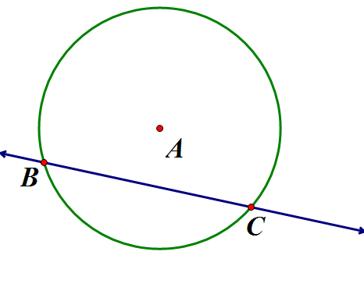
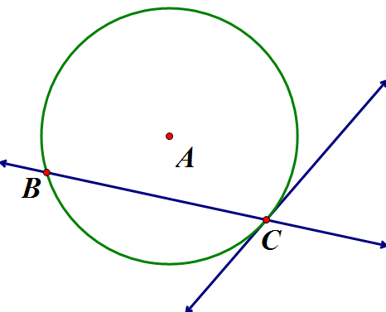
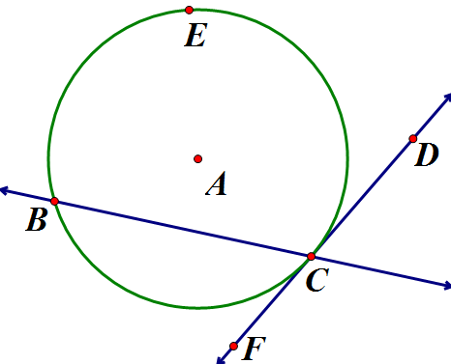
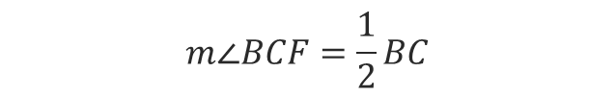
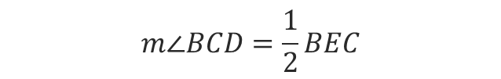
So that’s a theorem!
  If a secant and a tangent intersect at the point of tangency, then the measure of each angle formed is one-half the measure of its intercepted arc.
  Draw a picture of what you think that means!
$$m∠BCF=\frac{1}{2}BC$$
$$m∠BCD=\frac{1}{2}BEC$$

Slide 6
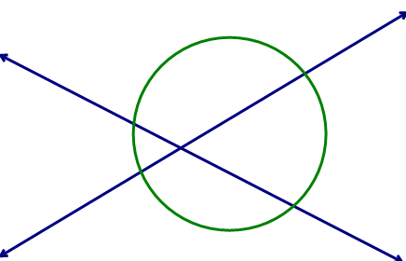
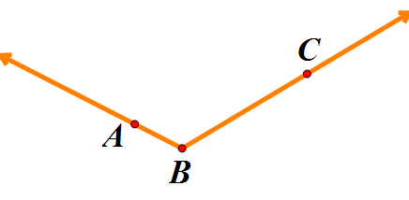
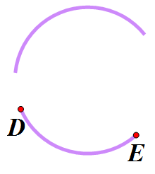


Another theorem:
  If two secants intersect in the interior of a circle, then the measure of an angle formed is one-half the sum of the measures of the arcs intercepted by the angle and its vertical angle.
  Draw it!
$\left( + \right)$
$\frac{1}{2}$
$m∠ABC=$

Slide 7
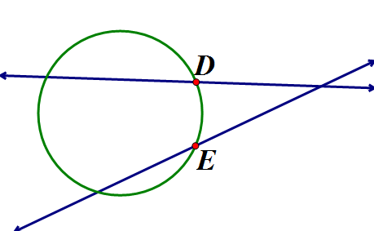
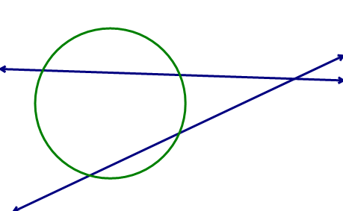
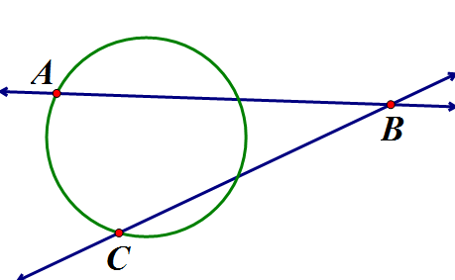
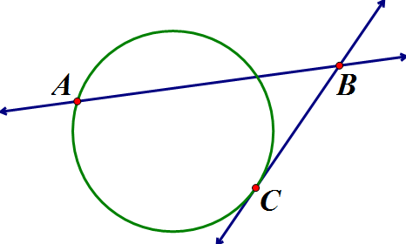
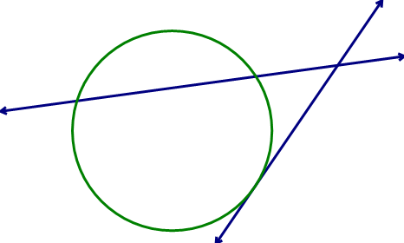
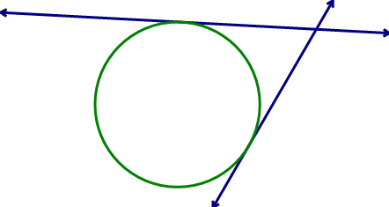
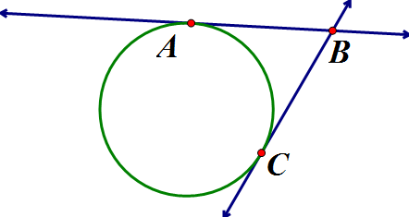


This theorem is wordy, so take a moment to think about it before writing it out:
  If two secants, a secant and a tangent, or two tangents intersect in the exterior of a circle, then the measure of the angle formed is one-half the positive difference of the measures of the intercepted arcs.
$\frac{1}{2}$
|( - )|
$m∠ABC=$

Slide 8
This theorem is wordy, so take a moment to think about it before writing it out:
  If two secants, a secant and a tangent, or two tangents intersect in the exterior of a circle, then the measure of the angle formed is one-half the positive difference of the measures of the intercepted arcs.
$\frac{1}{2}$
|( - )|
$m∠ABC=$

Slide 9
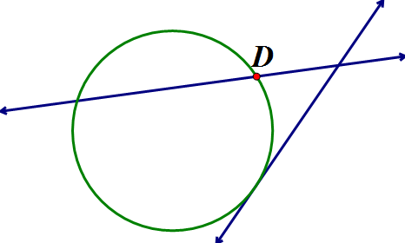
This theorem is wordy, so take a moment to think about it before writing it out:
  If two secants, a secant and a tangent, or two tangents intersect in the exterior of a circle, then the measure of the angle formed is one-half the positive difference of the measures of the intercepted arcs.
$\frac{1}{2}$
|( - )|
$m∠ABC=$

Slide 10
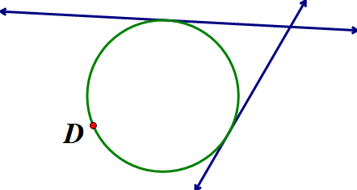
This theorem is wordy, so take a moment to think about it before writing it out:
  If two secants, a secant and a tangent, or two tangents intersect in the exterior of a circle, then the measure of the angle formed is one-half the positive difference of the measures of the intercepted arcs.
$\frac{1}{2}$
|( - )|
$m∠ABC=$

Slide 11
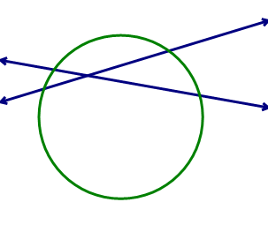



Examples
  Find the value of x.
85$°$
x$°$
2$30°$

Slide 12
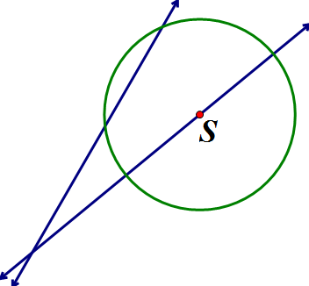



Examples
  Find the value of x.
$$84°$$
$$52°$$
x$°$

Slide 13
Summarize the theorems about secants, tangents, and the angles and arcs formed.

